Slide 1
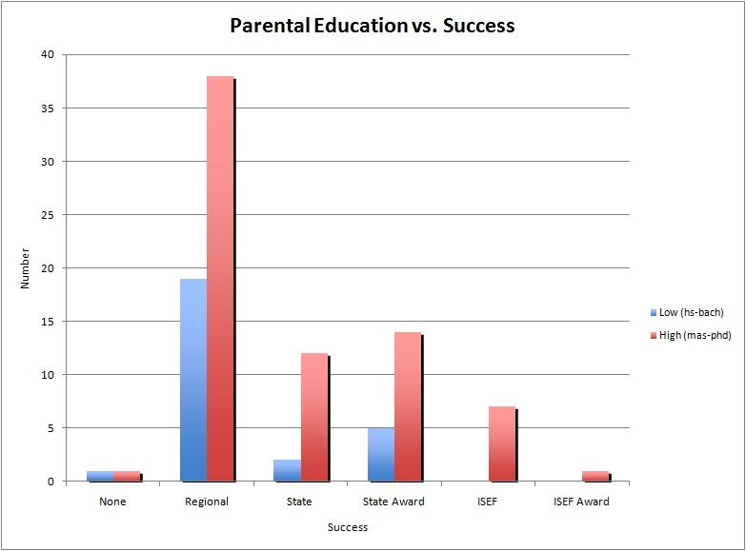
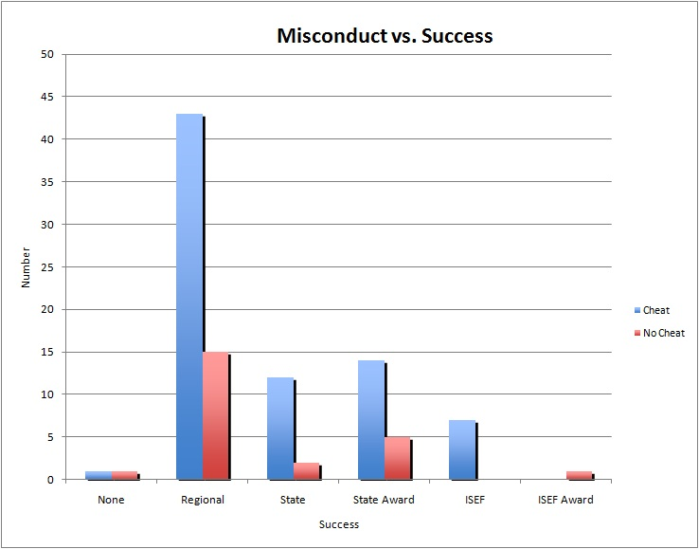
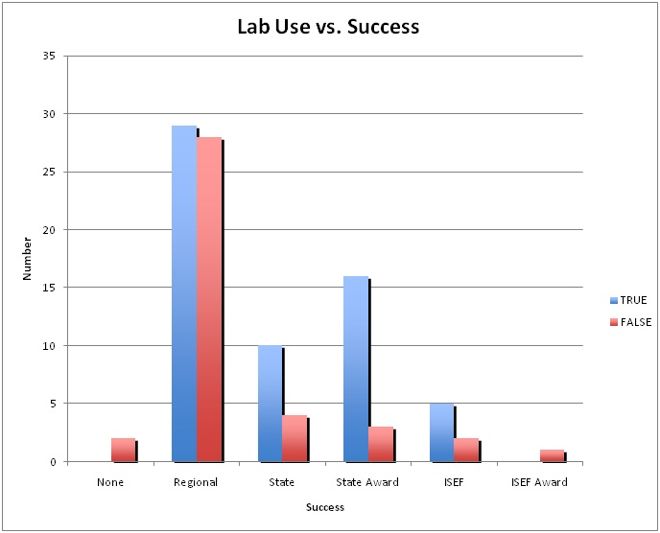
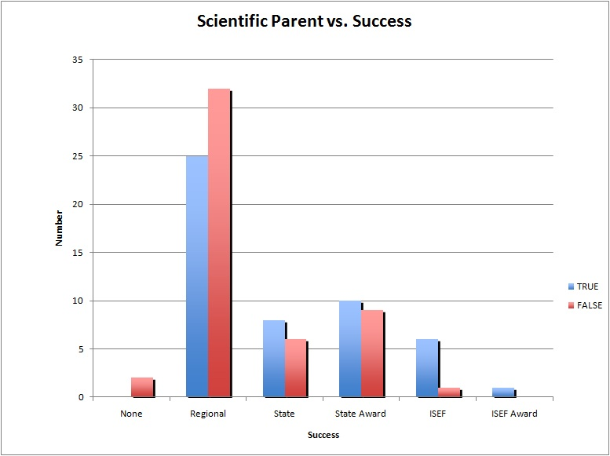
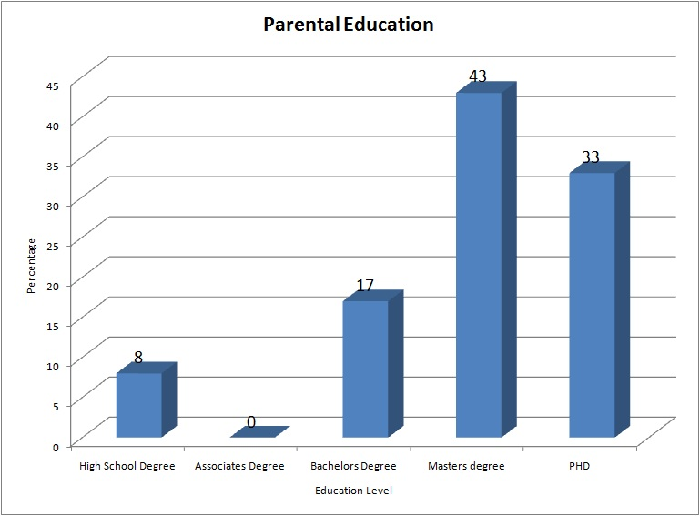
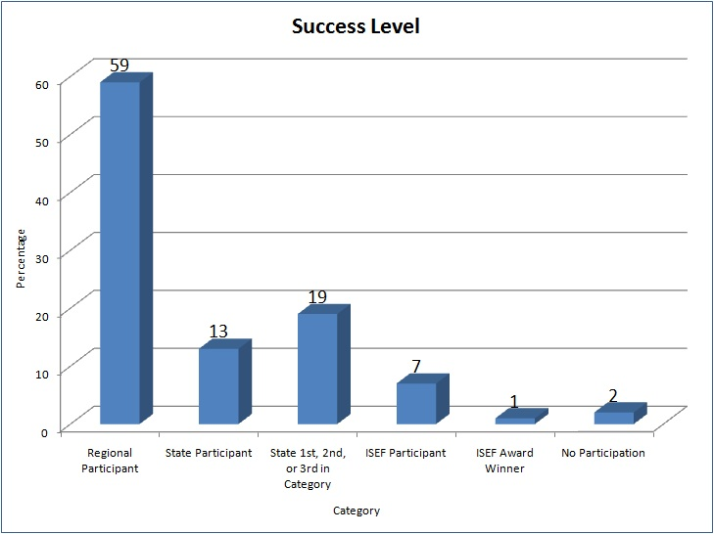
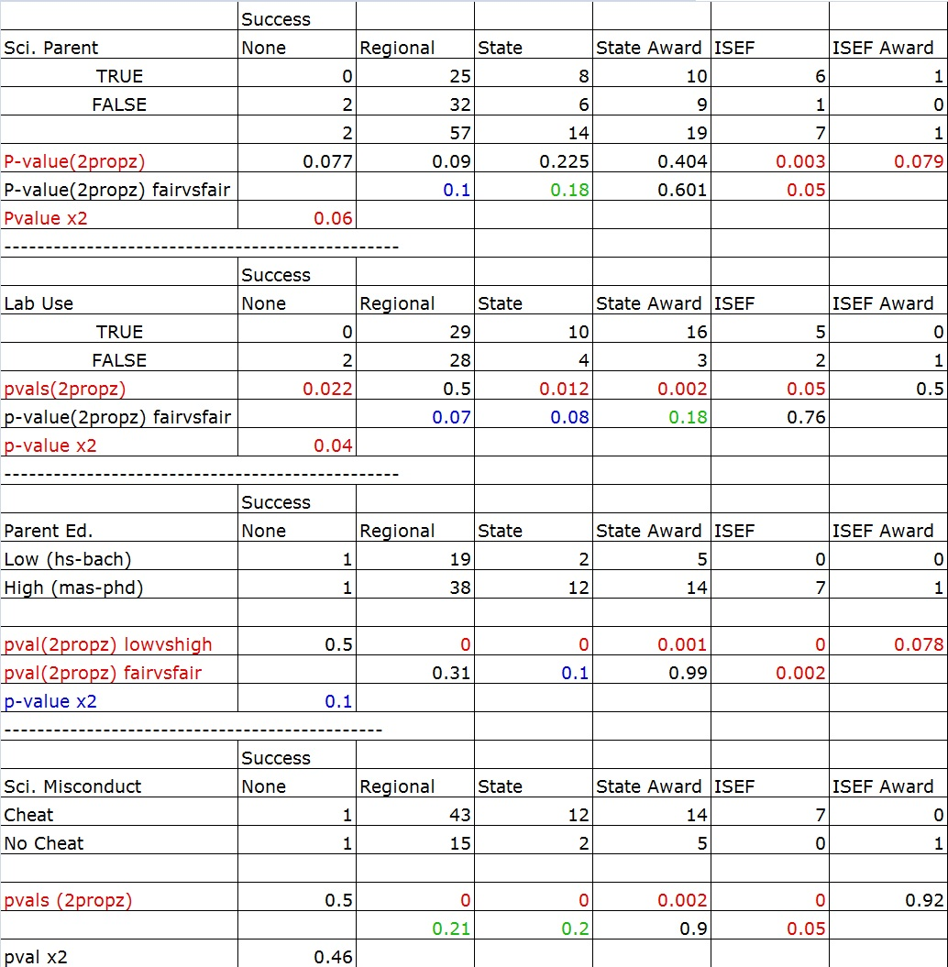
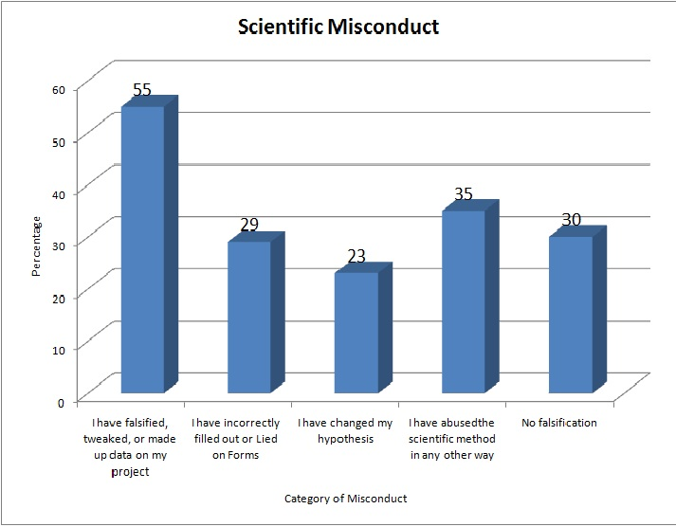

Introduction
Methodology
Graph 4: Parental Education
Graph 5: Research Misconduct
Results Cont.
Graph 6: Lab Use
Graph 7: Scientific Parent
Results
Table 1: Full Results with Inferential Statistics
Purpose
Graph 1:
Graph 2:
*
*
Conclusions
Hypothesis
Graph 3:

